Slide 1


Course Introduction
Fundamental Computer Programming C++
Dr. Ihsan Ullah
ihsan@saturn.yzu.edu.tw
Office: 60913

Slide 2
Course content
Chapter 1 Introduction
Chapter 2 Starting with C++
Chapter 3 Function in C++
Chapter 4 Class and Object in C++
Chapter 5 Constructor and Destructor
Chapter 6 Operator Overloading
Chapter 7 Inheritance in C++
Chapter 8 Pointer to Object and Virtual Functions
Chapter 9 Input-Output and Manipulator in C++
Chapter 10 File Handling in C++
Chapter 11 Template Programming
Chapter 12 Exception Handling in C++

Slide 3
Outline
Computer programming
Our first C++ program: basic structure and cout
Our second C++ program: variable declaration and cin
Our third C++ program: the if statements
Formatting a C++ program

Slide 4
Computer programming
What are computer programs?
The elements working in computers.
Also known as software.
A structured combination of data and instructions used to operate a computer to produce a specific result.
Strength: High-speed computing, large memory, etc.
Weakness: People (programmers) need to tell them what to do.
How may a programmer tell a computer what to do?
Programmers use “programming languages” to write codes line by line and construct “computer programs”.
Running a program means executing the instructions line by line and (hopefully) achieve the programmer’s goal.

Slide 5
Programming languages
People and computers talk in programming languages.
A programming language may be a machine language, an assembly language, or a high-level language (or something else).
Machine and assembly languages: Control the hardware directly, but hard to read and program.
High-level languages: Easy to read and program, but need a “translator.”
Most application software are developed in high-level languages.
The language we study in this course, C++, is a high-level language.
Some others HL Languages: Basic, Quick Basic, Visual Basic, Fortran, COBOL, Pascal, Delphi, C, Perl, Python, Java, C#, PHP, Matlab, etc.
A compiler translates C++ programs into assembly programs.
For other high-level programs, an interpreter may be used instead.

Slide 6
Object-Oriented Programming (OOP)
C++ is an object-oriented programming language, which means it supports the concepts of classes and objects.
Key Concepts: Encapsulation, Inheritance, Polymorphism, Abstraction.
Example: Car Manufacturing
Encapsulation: Car object encapsulates (restrict the direct access) data (model, color) and behavior (start, stop).
Inheritance: Different types of cars inherit common properties and behaviors from a base class.
Polymorphism: Same interface (e.g., "drive()") behaves differently based on the type of car.
Abstraction: Users interact with cars without needing to know internal mechanics.

Slide 7
The C++ programming language
C++ was developed by Bjarne Stroustrup at Bell Laboratories (formerly AT&T Bell Laboratories) over a period starting in 1979
C++ originates from another programming language C.
C developed in the early 1970s by American computer scientist Dennis M. Ritchie at AT&T Bell Lab.
C is a procedural programming (step-by-step) language.
C++ is an object-oriented programming (OOP) language..
C++ is (almost) a superset of C.
Most C programs can be complied by a C++ compiler.

Slide 8
Integrated development environment
Visual Studio
CodeBlock
Dev-C++
CLion

Slide 9
Our first C++ program
As in most introductory computer programming courses, let’s start from the “Hello World” example:
#include <iostream> using namespace std;
int main()
{
cout << "Hello World! \n"; return 0;
}
Let’s try to compile this source code and run it!

Slide 10
Our first C++ program
The program can be decomposed into four parts.
The preprocessor.
The namespace.
The main function block.
The statements.
Some words are colored because they are C++ reserved words (keywords), which serve for special purposes.
We will talk about them soon.
#include <iostream> using namespace std;
int main()
{
cout << "Hello World! \n"; return 0;
}

Slide 11
The preprocessor and namespace
Preprocessor processes the source code before it passes through the compiler.
Namespaces used to organize code into logical groups and prevent naming conflicts, such as variables, functions, or classes
#include <iostream> using namespace std;
At this moment, let’s ignore the first two lines.
They are doing some preparations before you may write your own instructions.
To be discussed later.
For now, just copy them.
int main()
{
cout << "Hello World! \n"; return 0;
}

Slide 12
The main function block
A C++ Program always runs from the first line of “the main function block” to the last line.
The function is named main().
One program, one main function.
A pair of braces (curly brackets)
#include <iostream> using namespace std;
int main()
defines a block.
– Within { and return 0;, we write our statements to tell the program what to do.
For now, just copy them.
{
cout << "Hello World! \n"; return 0;
}

Slide 13
Statements
There are always some statements in the main function.
return 0; is also a statement.
The computer executes the first statement, then the second, then the third….
Each C++ statement is ended with a
semicolon (;).
There are two statements in this main function.
#include <iostream> using namespace std;
int main()
{
cout << "Hello World! \n"; return 0;
}

Slide 14
cout and <<
cout << "Hello World! \n";
cout is a pre-defined object for “console output”.
It sends whatever data passed to it to the standard display device.
Typically this is a computer screen in the console mode.
The insertion operator << marks the direction of data flow.
Data “flow” like streams.
"Hello world! \n" is a string.
Characters within a pair of double quotation marks form a string.
cout << "Hello world! \n":
Let the string "Hello world! \n" flow to the screen. The character H first, then e, then l….

Slide 15
The escape sequence \n
cout << "Hello World! \n";
But wait… what is that “\n”?
In C++, the slash symbol “\” starts an escape sequence.
An escape sequence represents a “special character” that does not exist on the keyboard.
The newline character \n in C++ means “changing to a new line”.
To see this, try the following codes:
cout << "Hello World! \n";
cout << "I love C++\n so much!";

Slide 16
Escape sequences
Some common escape sequences are listed below:
Escape sequence
Escape sequence
Effect
Effect
\n
\t
\b
\a
A new line
A horizontal tab A backspace
A sound of alert
\\
\'
\"
A slash: \
A single quotation: '
A double quotation: "

Slide 17
Concatenated data streams
The insertion operator << can be used to concatenate multiple data streams in one single statement.
– The two statements
cout << "Hello World! \n";
cout << "I love C++\n so much!";
and this statement
cout << "Hello World! \n" << "I love C++\n
display the same thing.
Note that the statement
so much!";
"Hello World!" >> cout;
is wrong!

Slide 18
Our first C++ program as a whole
This is our first C++ program:
#include <iostream> using namespace std;
int main()
{
cout << "Hello World! \n"; return 0;
}
Go modify the statements by yourself!

Slide 19
Outline
Computer programming
Our first C++ program: basic structure and cout
Our second C++ program: variable declaration and cin
Our third C++ program: the if and while statements
Formatting a C++ program

Slide 20
The cin object
The cout object prints out data to the console output.
Another object, cin, accepts data input (by the user or other programs) from the console input (typically the keyboard).
In order to use the cin object, we need to first prepare a “container” for the input data. The thing we need is a variable.
When we use a single variable to receive the data, the syntax is
cin >> variable;
In this week, you will use the cin object to interact with your program.
In the future, you will use cin to read testing data of your program.
Let’s first learn how to declare variables.

Slide 21
Variables and data types
A variable is a container that stores a value.
Once we declare a variable, the system allocates a memory space for it.
A value may then be stored in that space.
In C++, each variable must be specified a data type.
It tells the system how to allocate memory spaces.
The data type will also determine how operations are performed on the variable.

Slide 22
Basic data types
There are ten basic (or built-in or primitive) data types in C++.
– They are provided as part of the C++ standard.
Category | Type | Bytes | Type | Bytes
 | bool | 1 | long | 4
Integers | char int | 1 4 | unsigned int unsigned short | 4 2
 | short | 2 | unsigned long | 4
Fractional numbers | float | 4 | double | 8
There are ten basic data types, belonging to two categories.
– The number of bytes is compiler-dependent.
Today let’s use integer and Boolean variables only.

Slide 23
Variable declaration
Before we use a variable, we must first declare it.
– We need to specify its name and data type.
The syntax of a variable declaration statement is
Address
Identifier
Value
type variable name;
– For example,
int myInt;
declares an integer variable called myInt.
A variable name is an identifier.
We do not need to memorize the memory address (which is a sequence of numbers).
We access the space through the variable name.
0x22fd4c
myInt
???
Memory

Slide 24
Declaration and assignment
Address
Identifier
Value
Beside declaring a variable, we may also assign
values to a variable.
int myInt; declares an integer variable.
myInt = 10; assigns 10 to myInt.
We may do these together.
0x20c648
yourInt
5
type variable name = initial value;
int yourInt = 5; declares an integer variable yourInt and assigns 5 to it.
The assignment is called initialization if it is done with declaration.
Without initialization, the variable may be of any value (depending on what was left since the last time this space is used)!
0x22fd4c
myInt
?1?0?
Memory

Slide 25
More about variable declaration
We may declare multiple variable in the same type together:
– int a, b, c; declares three integers a, b, and c.
We may initialize all of them also in a single statement:
int a = 1, b = 2, c = 3;
A variable’s name consists of a consecutive sequence of letters, digits, and the underline symbol “_”.
It cannot begin with a number.
It cannot be the same as a C++ keywords.
It (and the whole C++ world) is case-sensitive.
Always initialize your variables (e.g., 0).
Use meaningful names (e.g., yardToInch is) better than y).
Capitalize the first character of each word, but not the very first one.
– int yardToInch = 12, avgGrade = 0, maxGrade = 100;

Slide 26
Our 2nd C++ program (in progress)
This is our second C++ program (to be completed later):
We first declare and initialize two integers.
We then do
cout << num1 + num2;
There are two operations here:
num1 + num2 is an addition operation. The sum will be returned to the program.
That returned value is then sent to cout
through <<.
As a result, 17 is displayed on the screen.
#include <iostream> using namespace std;
int main()
{
int num1 = 13, num2 = 4; cout << num1 + num2;
return 0;
}

Slide 27
When we execute this program
Address
Identifier
Value
#include <iostream> using namespace std;
(3)
0x20c630
(no name)
17
int main()
{
int num1 = 13, num2 = 4;
cout << num1 + num2;
(1)
0x20c648
num1
13
return 0;
}
(2)
0x22fd4c
num2
4
(4)
17
Console
Memory

Slide 28
Our 2nd C++ program (in progress)
Let’s make the output look better:
#include <iostream> using namespace std;
int main()
{
int num1 = 13, num2 = 4;
cout << "The sum of " << num1 << " and " << num2 << " is "
<< num1 + num2 << "\n";
return 0;
}
How would you interpret the program?

Slide 29
Our 2nd C++ program (in progress)
#include <iostream> using namespace std;
There are other arithmetic operations:
Addition, subtraction, multiplication, division, and modulus.
What will be displayed on the screen?
int main()
{
int num1 = 13, num2 = 4;
cout << num1 + num2 << "\n"; cout << num1 - num2 << "\n"; cout << num1 * num2 << "\n"; cout << num1 / num2 << "\n"; cout << num1 % num2 << "\n";
return 0;
}

Slide 30
Our second C++ program
Now we are ready to present our second C++ program:
#include <iostream> using namespace std;
int main()
{
int num1 = 0, num2 = 0;
cout << "Please enter one number: "; cin >> num1;
cout << "Please enter another number: "; cin >> num2;
cout << "The sum is " << num1 + num2; return 0;
}

Slide 31
The cin object
In this example, we allow the user to enter two numbers.
We declare two variables to receive the inputs.
We then use the cin object to send input values into the variables.
cout << "Please enter one number: "; cin >> num1;
cout << "Please enter another number: "; cin >> num2;
The cout statements are prompts: a message telling the user what to do.
The input of a value ends when the user press “enter”.
The variables (and their values) can then be used in other statements.
cout << "The sum is " << num1 + num2;

Slide 32
The cin object
The extraction operator >> is used with the cin object.
One cannot use cout with >> or cin with <<!
Both statements here are wrong:
a >> cout;
b << cin;
The input stream is split into multiple pieces by “enter” and white spaces.
Different pieces are sent to different variables.
If the number of variables is fewer than the input pieces, pieces will be put in an input buffer waiting for future cin operations.
Try to run the program by entering “4 13”.

Slide 33
Our second C++ program
Another way to implement this program:
#include <iostream> using namespace std;
int main()
{
int num1 = 0, num2 = 0;
cout << "Please enter two numbers, separated by a white space: "; cin >> num1 >> num2;
cout << "The sum is " << num1 + num2;
return 0;
}
>> may send (pieces of) values to multiple variables.
Data types matter: What if we enter “1.3 4”?

Slide 34
Our third C++ program (in progress)
#include <iostream>
Would you guess what does this program do?
We use the if statement to control the sequence of executions.
using namespace std;
int main()
{
int num1 = 0, num2 = 0;
if (condition)
{
cout << "Please enter two numbers, "
<< "separated by a white space: "; cin >> num1 >> num2;
statements
}
if (num1 > num2)
cout << "The larger one is " << num1; if (num1 < num2)
cout << "The larger one is " << num2; if (num1 == num2)
cout << "The two are equal";
If condition returns true, do
statements sequentially.
Otherwise, skip those
statements.
What is ==?
return 0;

Slide 35
The comparison operators
• == checks whether the two sides of it are equal.
Returns a Boolean value: true (non-zero) or false (zero).
• = and == are different!
When we write a = 20, it assigns 20 to a. The value 20 is then returned.
When we write a == 20, it checks whether a equals 20. Either true or false
is then returned.
What happens to the following three programs?
int a = 0; if(a == 1)
{
cout << "here!";
}
int a = 0; if(a = 1)
{
cout << "here!";
}
int a = 0; if(a = 0)
{
cout << "here!";
}
Do distinguish “becomes” and “equals”!
– a = 20 is read as “a becomes 20”. a == 20 is read as “a equals 20”.

Slide 36
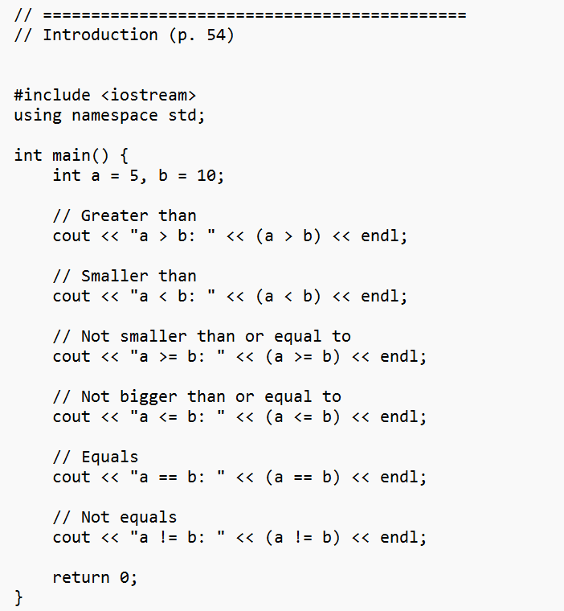
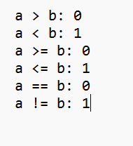
The comparison operators
All the following comparison operators return a Boolean value.
>: bigger than
<: smaller than
>=: not smaller than
<=: not bigger than
==: equals
!=: not equals

Slide 37
The if statement
In an if block, there may be multiple
statements.
A pair of curly brackets are used to define the block.
int a = 0; if(a == 1)
{
cout << "he"; cout << "re!";
}
We may drop { } if, and only if, there is
only one statement under the if statement.
int a = 0; if(a == 1)
cout << "here!";
What will happen to this program?
int a = 0; if(a == 1)
cout << "he"; cout << "re!";

Slide 38
Formatting a C++ program
In a C++ program, semicolons are marks of the end of statements.
White spaces, tabs, and new lines do not affect the compilation and execution of a C++ program.
– Except strings and preprocessor commands.
The following two programs are equivalent:
#include <iostream> using namespace std;
#include <iostream> using namespace std; int main (){cout << "Hello
World! \n“;return 0;}
int main()
{
cout << "Hello World! \n"; return 0;
}

Slide 39
Formatting a C++ program
Maintaining the program in a good format is very helpful.
While each programmer may have her own programming style, there are some general guidelines.
Start a new line after each semicolon.
Align paired braces vertically.
Indent blocks according to their levels.
Write comments.

Slide 40
Formatting a C++ program
Start a new line after each semicolon.
Never put two statements in the same line!
Align paired braces vertically.
Which one do you prefer?
int main() int main()
int main() {
{ | { | int a = 5;
int a = 5; | int a = 5; | if(a < 5) {
if(a < 5) | if(a < 5) | cout << "...";
{ | { | cout << "...";
cout << "..."; | cout << "..."; | }
cout << "..."; | cout << "..."; | return 0;
} return 0; | } return 0; | }
} | }

Slide 41
Indentions
Indent blocks according to their levels.
– Which one do you prefer?
int main()
{
int a = 5;
int main()
{
int a = 5;
int main()
{
int a = 5;
if(a < 5)
{
cout << "...";
cout << "...";
}
return 0;
if(a < 5)
{
cout << "...";
cout << "...";
}
return 0;
}
if(a < 5)
{cout << "...";
cout << "...";
}
return 0;
}
}

Slide 42
Comments
Comments are programmers’ notes and will be ignored by the compiler.
In C++, there are two ways of writing comments:
A single line comment: Everything following a // in the same line are treated as comments.
A block comment: Everything within /* and */ (may across multiple lines) are treated as comments.
/* This is my first C++ program*/
#include <iostream> using namespace std;
int main()
{
cout << "Hello World! \n";
return 0; // the program terminates correctly
}

